Slide 1
CSD1401
Finale
Week 13 Submissions
Week 14 Presentations
Grading
CSD1451

Slide 2

Submissions
Week 13

Slide 3
Items to submit by end of Week 13
Final Project submission (according to rubrics)
Product video
(10 seconds)

Slide 4
Final Submission (Examples)

Slide 5

Contents

Slide 6

DOCUMENTS (folder)
Minimum
Project Rubrics need to be filled by students.
All the blue sections.

Slide 7
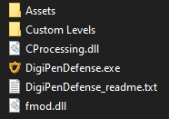
PRODUCT (folder)
The product should be able to run with just this folder.

Slide 8
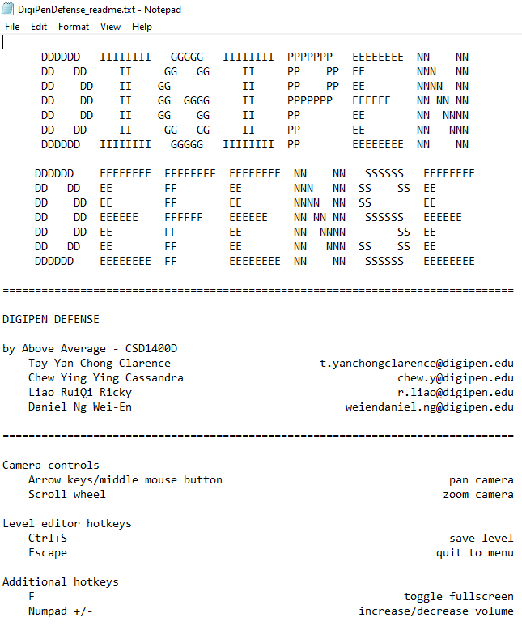
Readme
Minimum

Slide 9
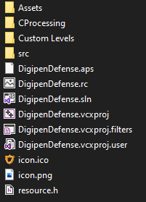
SOURCE (folder)
Should be able to compile and run your project with this folder alone.
It is ok to have project files and other files you see here in a separate folder.

Slide 10
SOURCE (folder)
Make sure there are no generated files in your SOURCE folder
Examples : .pdb, .obj, etc.
These files should already be ignored by your git ignore file

Slide 11

Final Presentation (Week 14)

Slide 12
Where & When
Lecture Theatre 4A and 4B (Level 4)
Week 14 Monday

Slide 13
What do you need
Every team will be given 5 minutes to present
You will be presenting 2 main things :
Your product
Reflections

Slide 14
Your Product
Introduce what your product is about
Overall concept
Unique selling points
Show highlights and achievements
Live play through

Slide 15
Reflections
“An analysis or discussion of an event held soon after it has occurred, especially in order to determine why it was a failure.”
Share your reflections of the process of this project with the class (examples) :
What went right
What went wrong
What changes were made based on feedback
How testing helped
What did you learn
What do you want to improve on next time
etc

Slide 16
Reflections (Class activity)

Slide 17
Platform
Your Own Laptop
Each team connects the visual/audio cables at the podium to their laptop and presents.

Slide 18
Where When
Both LT 4A and 4B used concurrently
Session time slots:
1000h – 1140h
1300h – 1440h
1500h – 1640h
Refer to Presentations Channel on MS Teams to see which LT and Session your team is in

Slide 19
Decorum
Give your attention to the teams presenting
Do not do your own work or play games during presentation

Slide 20

Grading

Slide 21
Grade Releases
Within Fall2022 Week 14/15:
Final presentation
Product video
Within Spring2023 Week 1:
Final project (with feedback in rubrics)
Final CSD1401 Grade

Slide 22
Expectations
I can only grade with what I have on hand
I will not be calling you up for clarifications
Make sure the right stuff reaches me

Slide 23
Expectations
Your work needs to speak for itself
There are sections for comments in your final project rubric
Your code and game should be understandable

Slide 24
Recall…. (Weeks 8 – 13)
Team Project
Unguided, weekly targets set by the team
Everyone must contribute meaningfully to the project
Code contributions from everyone
Penalties for lack of contribution, failure of this class if no contribution

Slide 25
Contribution Grading
Weekly Production Updates
Context of work done (complexity, type, etc)
Hours put in
Task completion (Integrated)
Penalties for lack of contribution
Failure of class for no contribution
Notes:
Last Chance

Slide 26
Responsibility
All the submissions are team submissions
All members are responsible for what is being submitted
Remember
I only grade what I receive
Submission speaks for itself

Slide 27
CSD1451
Episode II

Slide 28
Unlikely to change
Alpha Engine (same one used in CSD1130)
Draw your own shapes, etc.
Start coding in week 1
Project can be done in C or C++
Form teams in week 1
5 pax
Lecture and Lab sessions

Slide 29
Expectations of you
Know your stuff (Trimester 1 content)
C programming fun
Basic linear algebra for games
presentation skills
Binary, hex, octal, endianness
Logical expressions

Slide 30
Expectations of you
Create a game
Stability
Memory allocation
Consistency
Task design and troubleshooting
Coordination and communication
Bug fixing
Group work and work allocation
Planning
Code design and structure
Logic
Version control
User experience

Slide 31
Expectations of you
Work as a team
Effective communication
Strengths and weaknesses
Help each other
Common ground
Collaboration
Tone
Respect

Slide 32
Finally

Slide 33
Thank your TAs

Slide 34
Thank you for the hard work
Good show
Good rest

Slide 35
Feedback please
Did Splash Screen, CSG, GOL help? How can they be improved?
What content would help you? When should they be given?

